Slide 1
Machine Learning Prediction of Companies’ Business Success or failure
Compiled by Holiness Supremacy Mhlanga

Slide 2
WHY SHOULD WE PREDICT COMPANY SUCCESS OR FAILURE?
Risk Mitigation
Strategic Planning
Competitive Advantage
Investment Decisions
Operational Efficiency
Customer Experience
Talent Management
Regulatory Compliance
Strategic Alliances
Long-Term Sustainability

Slide 3
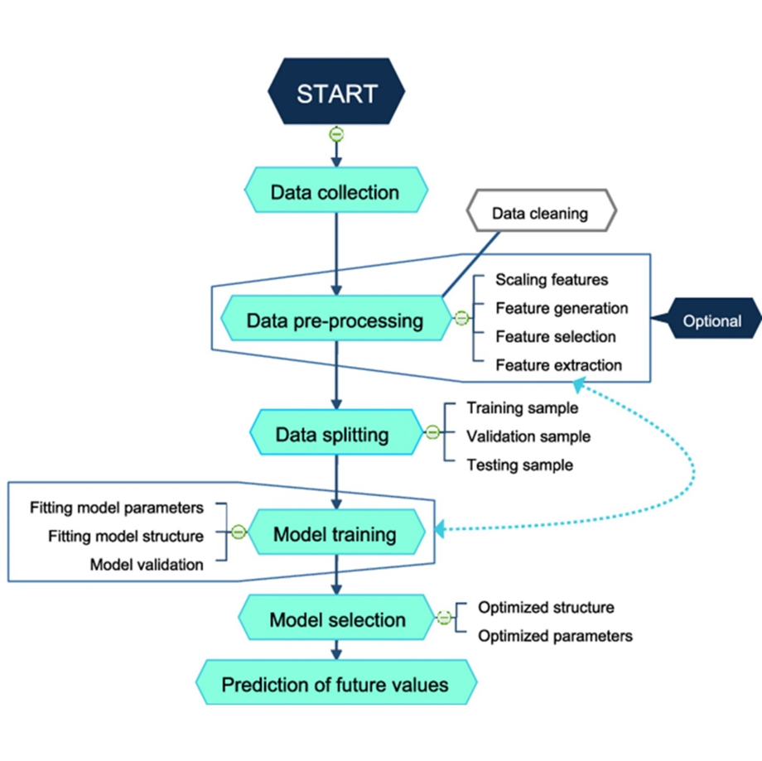
WORKFLOW OF THE MODEL

Slide 4
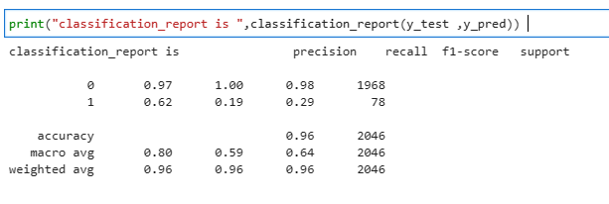
Classification report for Logistic regression>

Slide 5
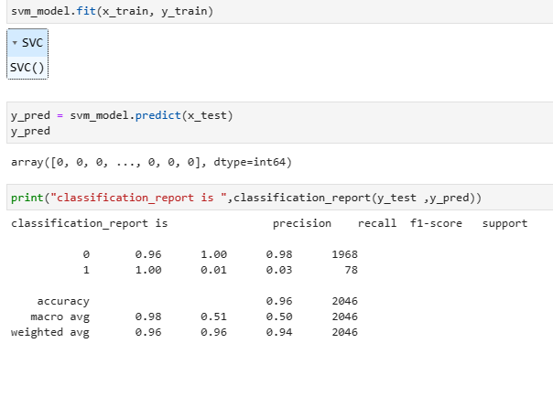
Classification report for SVM

Slide 6
Future developments
Interpretable Models: While complex models like deep learning can achieve high accuracy, they often lack interpretability, which is crucial for understanding the factors driving bankruptcy predictions. Future developments may focus on creating models that strike a balance between accuracy and interpretability, such as using techniques like attention mechanisms to identify important features in the data.
Dynamic Models: Traditional bankruptcy prediction models often assume static relationships between predictors and bankruptcy risk. Future models may incorporate dynamic features that capture how these relationships change over time, allowing for more accurate predictions in dynamic economic environments.
Ensemble Methods: Ensemble methods, which combine predictions from multiple models, could be further explored for bankruptcy prediction. By aggregating predictions from diverse models, ensemble methods can potentially improve prediction accuracy and robustness.
Transfer Learning: Transfer learning, where models trained on one dataset are fine-tuned on another related dataset, could be applied to bankruptcy prediction. Pre-trained models could capture general patterns in financial data, which can then be fine-tuned on specific bankruptcy prediction tasks, potentially reducing the need for large labeled datasets.
REGRESSION IMPLEMENTATION

Slide 7
LET’S GET INTO THE CODE****

